Slide 1
NHL PLAYOFF MODEL
Ethan Greig
2018-04-10

Slide 2
PURPOSE
Regression model for NHL playoff series winners
Direct comparison of opponents’ team statistics
Teams are not given individual scores
 | Wins | Goals For | Goals Against
Team A | 42 | 254 | 241
Team B | 36 | 279 | 278
Difference | +6 | -25 | -37
Team A Win Probability:
0.57

Slide 3
DATA COLLECTION
10 seasons of regular season and playoff data (since 2007-08)
Sourced from various websites, by exporting or copy-pasting to CSV
NHL.com
Corsica Hockey
MoreHockeyStats.com
Combined into one R dataframe

Slide 4

INPUT VARIABLES
GF% | Goals For Percentage
AdjGF% | Non-Empty Net Goals For Percentage
5v5_xGF% | 5-on-5 Expected Goals For Percentage
5v5_CF% | 5-on-5 Shot Attempts For Percentage
5v5_Sh% | 5-on-5 Team Shooting Percentage
5v5_Sv% | 5-on-5 Team Save Percentage
PP% | Power Play Percentage
PK% | Penalty Kill Percentage
Time_Led | Minutes Per Game With the Lead
ROWins | Number of Non-Shootout Wins

Slide 5
VARIABLE CORRELATIONS
Calculate correlation between each team statistic and team playoff success
Playoff success is measured by number of playoff wins
 | GF% | Adj GF% | 5v5 xGF% | 5v5 CF% | 5v5 Sh% | 5v5 Sv% | PP% | PK% | Time Led | R+OT Wins
5 years | 0.35 | 0.34 | 0.24 | 0.23 | -0.07 | 0.17 | -0.10 | 0.22 | 0.07 | 0.12
10 years | 0.34 | 0.33 | 0.21 | 0.18 | -0.03 | 0.11 | 0.06 | 0.20 | 0.21 | 0.15

Slide 6
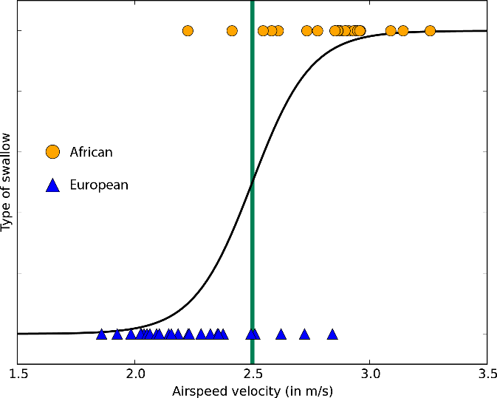
LOGISTIC REGRESSION
Selected a subset of the variables as input variables for the model
Difference between higher and lower seeded team is calculated for each statistic
Used playoff series result as response variable
Binary (won/lost)
Weighted (win% in series)

Slide 7
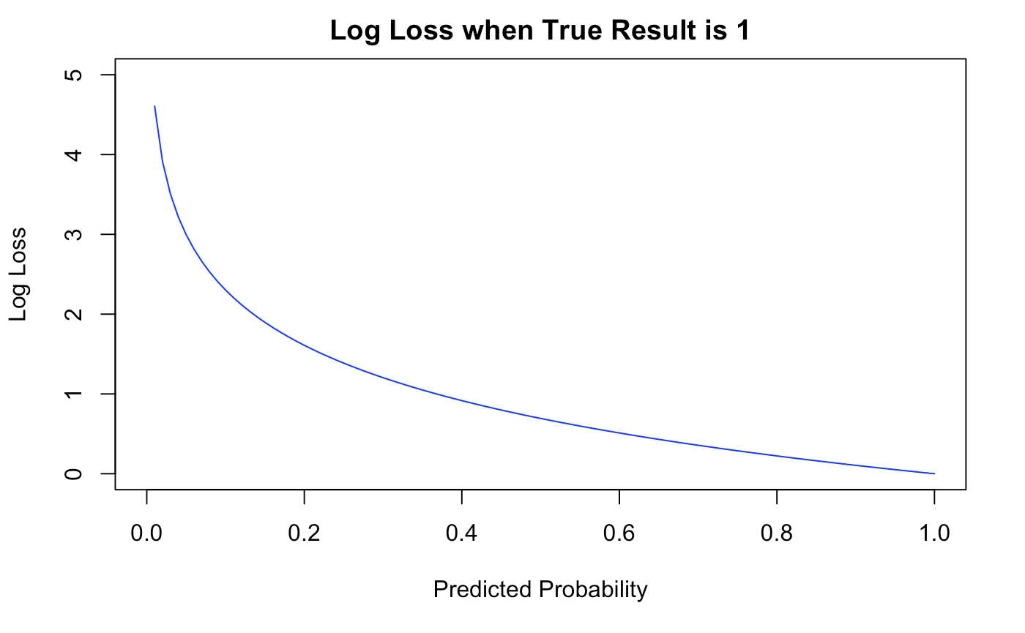
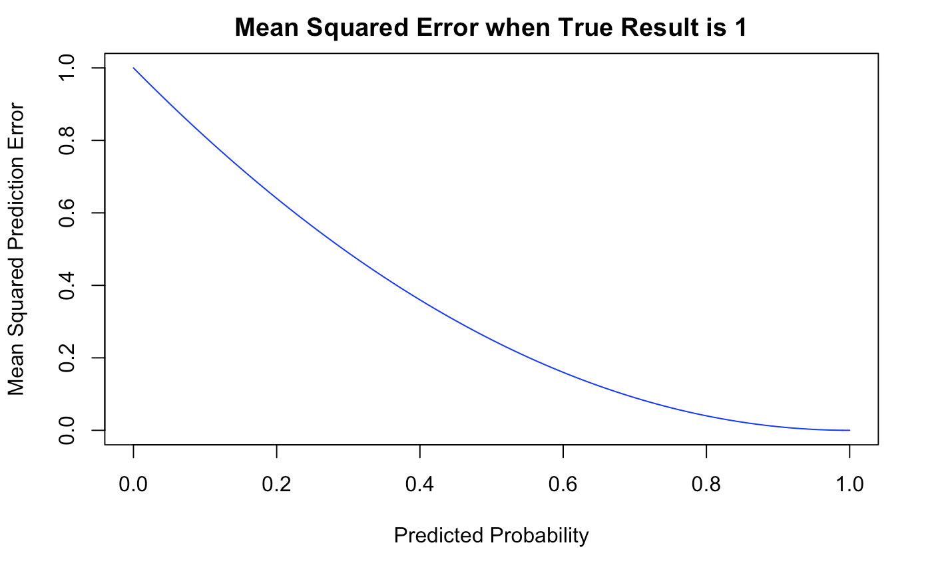
MODEL VALIDATION
Iterated 10-fold cross validation
Loss function averaged over test sets
Log Loss (~0.56)
Mean Squared Prediction Error (~0.23)
Resulted in some unintuitive coefficients

Slide 8
MULTICOLLINEARITY
 | GF% | Adj GF% | 5v5 xGF% | 5v5 CF% | Time Led | 5v5 Sh% | 5v5 Sv% | PP% | PK% | R+O Wins
GF% | 1.0 | 1.0 | 0.3 | 0.3 | 0.6 | 0.4 | 0.3 | 0.3 | 0.2 | 0.5
Adj GF% | 1.0 | 1.0 | 0.3 | 0.3 | 0.6 | 0.4 | 0.3 | 0.3 | 0.2 | 0.4
5v5 xGF% | 0.3 | 0.3 | 1.0 | 0.8 | 0.2 | -0.2 | -0.2 | 0.0 | 0.1 | 0.1
5v5 CF% | 0.3 | 0.3 | 0.8 | 1.0 | 0.1 | -0.4 | -0.2 | 0.0 | 0.1 | 0.1
Time Led | 0.6 | 0.6 | 0.2 | 0.1 | 1.0 | 0.4 | 0.1 | 0.3 | 0.0 | 0.3
5v5 Sh% | 0.4 | 0.4 | -0.2 | -0.4 | 0.4 | 1.0 | -0.1 | 0.1 | -0.1 | 0.2
5v5 Sv% | 0.3 | 0.3 | -0.2 | -0.2 | 0.1 | -0.1 | 1.0 | 0.0 | -0.1 | 0.1
PP% | 0.3 | 0.3 | 0.0 | 0.0 | 0.3 | 0.1 | 0.0 | 1.0 | -0.2 | 0.2
PK% | 0.2 | 0.2 | 0.1 | 0.1 | 0.0 | -0.1 | -0.1 | -0.2 | 1.0 | 0.0
R+O Wins | 0.5 | 0.4 | 0.1 | 0.1 | 0.3 | 0.2 | 0.1 | 0.2 | 0.0 | 1.0
Many of the 10 input variables are highly correlated
Statistical variation is hidden in complicated multicollinearity
Regression models work much better with independent variables

Slide 9
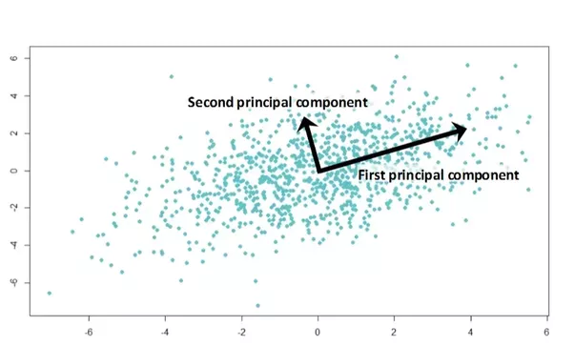
PRINCIPAL COMPONENT ANALYSIS
Extracts principal components from (normalized) input variables
These linear combinations of the variables are uncorrelated
Resulting components are sorted by decreasing impact on total variation
Whiteboard example of PCA

Slide 10
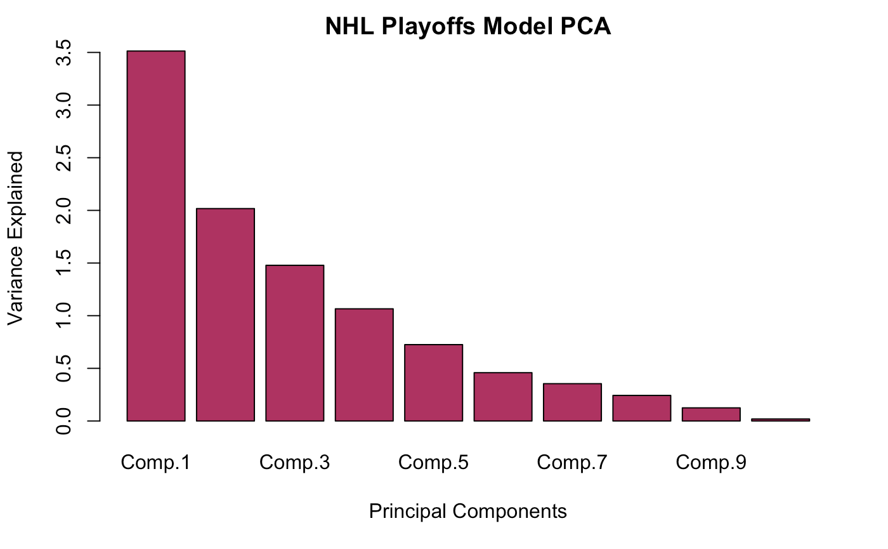
FINAL MODEL
 | Comp.1 | Comp.2 | Comp.3
ΔGF% | 0.49 | -0.09 | 0.24
Δ Adj GF% | 0.48 | -0.09 | 0.24
Δ 5v5 xGF% | 0.27 | 0.50 | -0.14
Δ 5v5 CF% | 0.24 | 0.57 | -0.06
Δ Time Led | 0.41 | -0.05 | -0.18
Δ 5v5 Sh% | 0.14 | -0.53 | -0.13
Δ 5v5 Sv% | -0.04 | -0.19 | 0.58
Δ PP% | 0.17 | -0.16 | -0.50
Δ PK% | 0.08 | 0.17 | 0.48
Δ R+O Wins | 0.41 | -0.20 | -0.07
Three components explain 70.1% of variance
Component 1: “Outscoring and Winning”
Component 2: “Possession and Shot Volume”
Component 3: “Defensive Inclination”
Other components do not have clear intuition

Slide 11
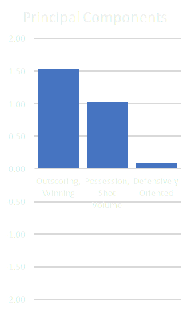

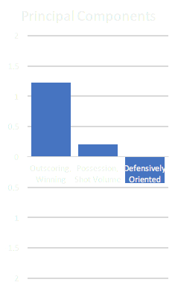



PREDICTIONS (CENTRAL)
75% ↑
64% ↑

Slide 12

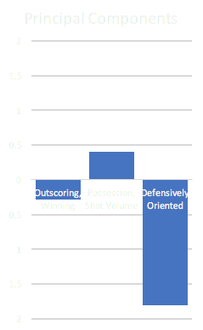
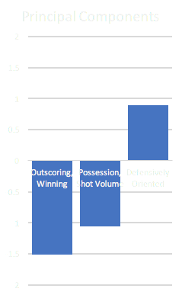



PREDICTIONS (PACIFIC)
36% ↓
47% ↓

Slide 13


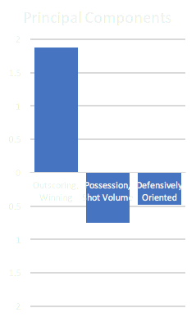
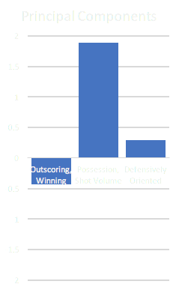


PREDICTIONS (ATLANTIC)
64% ↑
65% ↑

Slide 14

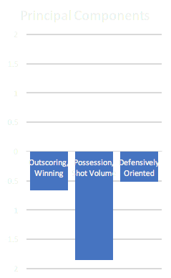

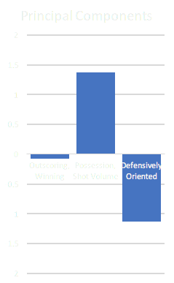


PREDICTIONS (METROPOLITAN)
36% ↓
50% ↑

